Slide 1
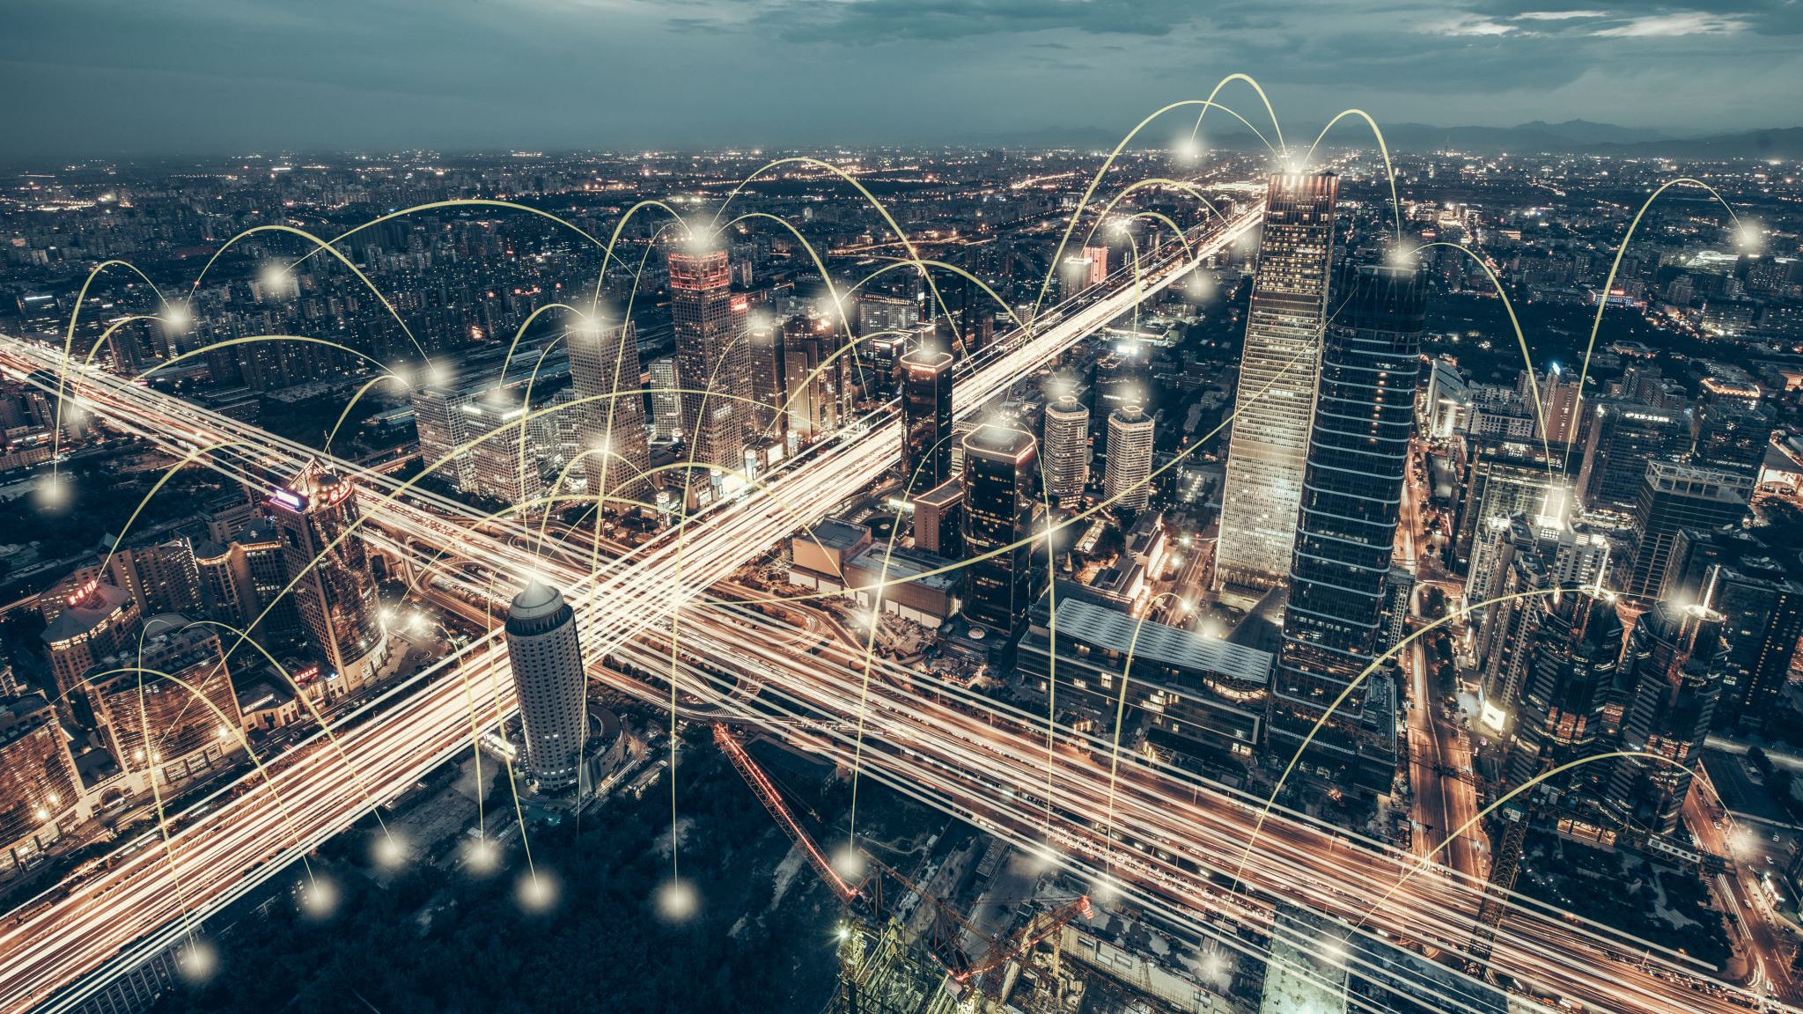
Smart City Traffic Management System
A Data-Driven Approach to Improve Urban Mobility
Presented by Group 7:
Nikhil, Maisha, Raghav, Rahul, Somya

Slide 2
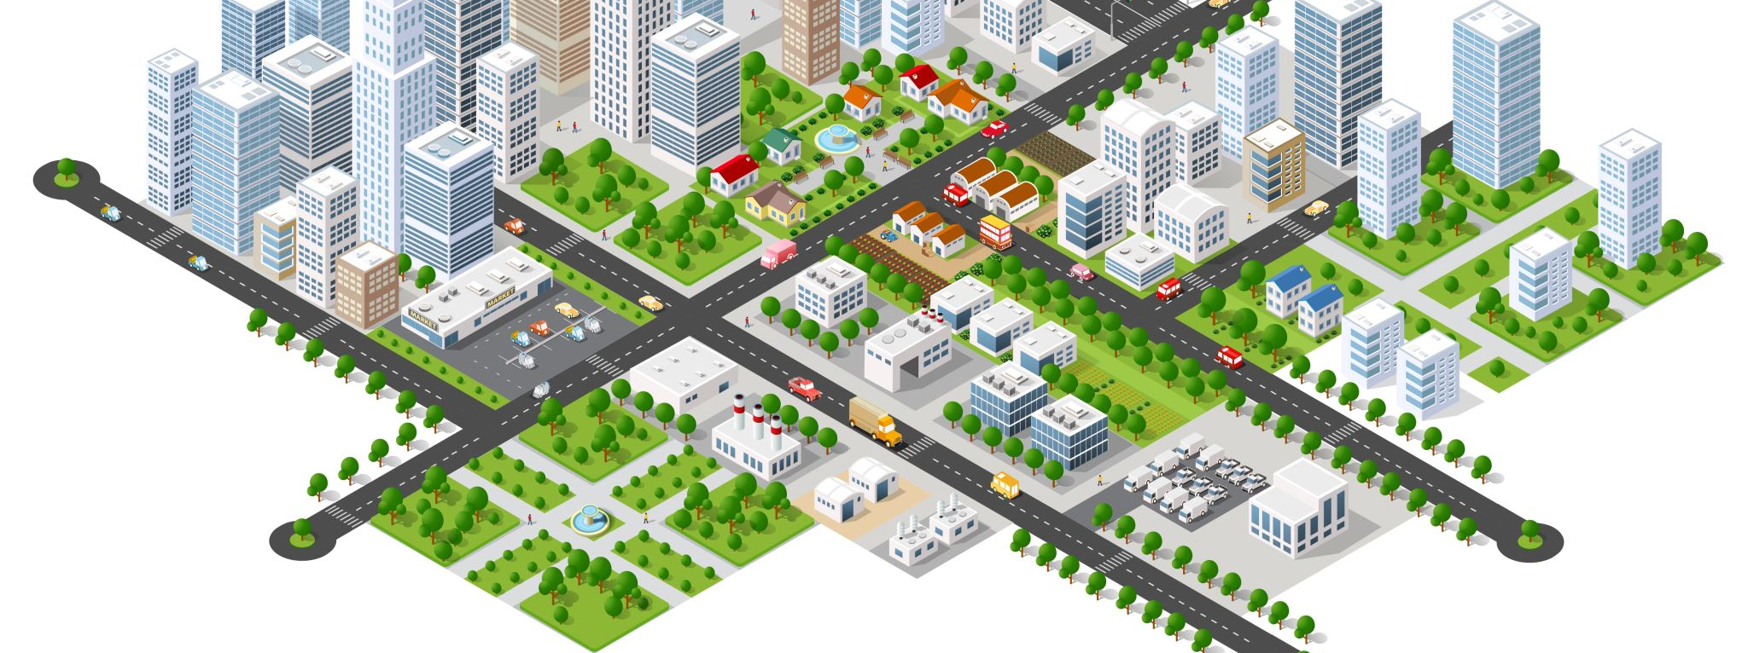
System/Project Selection
Chosen System: Smart City Traffic Management System Purpose: Enhance urban mobility and reduce congestion through data analytics.

Slide 3
Identified Bottlenecks
Traffic Congestion: High levels during peak hours.
Accident Management: Slow response times.
Inefficient Traffic Signals: Fixed timings not adaptive to real-time conditions.
Data Integration: Lack of integration between data sources.
Environmental Impact: High emissions in congested areas.

Slide 4
Stakeholders and Project Rationale
Stakeholders:
City Residents
City Government
Emergency Services
Public Transportation Authorities
Environmental Agencies
Businesses
Why:
Improve urban mobility.
Reduce congestion and travel times.
Enhance public safety.
Reduce vehicle emissions.

Slide 5

Functional Requirements
Real-Time Traffic Monitoring: Collect and display real-time data from cameras, sensors, and GPS.
Adaptive Traffic Signal Control: Adjust signal timings based on real-time traffic conditions.
Accident Detection and Management: Automatic detection of accidents and notification to emergency services.
Traffic Data Analysis: Analyze traffic patterns, predict congestion, and recommend alternative routes.
User Alerts: Provide real-time traffic alerts to drivers and commuters through mobile apps and digital signage.
Environmental Monitoring: Track vehicle emissions and air quality in congested areas.

Slide 6

Non-Functional Requirements
Performance: Process and respond to real-time data within 2 seconds.
Scalability: Handle data from up to 1 million vehicles and sensors in the city.
Security: Ensure data encryption and secure access to prevent unauthorized use.
Reliability: System uptime must be 99.9% with robust failover mechanisms.
Usability: Interfaces should be intuitive for both traffic operators and end-users.
Interoperability: Must integrate seamlessly with existing city infrastructure and third-party systems.
Maintainability: Easy to update and maintain with comprehensive documentation for system administrators.

Slide 7

Project Plan
Initiation Phase:
Define project scope and objectives.
Identify stakeholders and form the project team.
Develop a project charter.
Planning Phase:
Conduct stakeholder meetings to gather detailed requirements.
Develop a detailed project plan with timelines, milestones, and deliverables.
Assess and plan for potential risks and mitigation strategies.
Execution Phase:
Design system architecture and user interfaces.
Develop the system using an Agile methodology with iterative sprints.
Regularly review progress with stakeholders and incorporate feedback.
Testing Phase:
Conduct unit, integration, and system testing.
Perform load testing to ensure the system can handle peak traffic data.
Conduct user acceptance testing (UAT) with traffic operators and select end-users.
Deployment Phase:
Prepare a detailed deployment plan and backup strategies.
Deploy the system in a controlled environment and gradually scale up.
Monitor system performance and address any post-deployment issues.
Closure Phase:
Obtain formal acceptance from stakeholders.
Conduct a project review and document lessons learned.
Handover system documentation and provide training sessions for end-users and administrators.

Slide 8

Methodology
Agile Development: Iterative and incremental development to allow flexibility and continuous stakeholder feedback.
Data-Driven Decision Making: Utilize advanced data analytics and machine learning algorithms to optimize traffic flow and predict congestion.
User-Centered Design: Focus on creating user-friendly interfaces for traffic operators and end-users.
Continuous Integration and Continuous Deployment (CI/CD): Automate testing and deployment to ensure quick and reliable updates.

Slide 9

Benefits and Impact
Improved Urban Mobility: Reduced congestion and travel times.
Enhanced Public Safety: Faster accident response.
Environmental Benefits: Reduced emissions.
Economic Growth: Improved transportation for businesses.

Slide 10
Conclusion
Summary:
A comprehensive approach to smart traffic management.
Benefits for residents, government, and businesses.
Next Steps:
Gather stakeholder feedback.
Finalize requirements.
Begin development.

